Slide 1

Understanding Employee
Stress Level
ECE 229 Group 7 - Spring 2021
Notes:
Good evening everyone! We are group 7 and our investigation is on understanding employee stress level

Slide 2
Agenda
Motivation -- User Story | Slide 3-4
Dataset | Slide 5
Model Prediction | Slide 6
AWS Dashboard Architecture | Slide 7
OKR - Obstacles and Challenges | Slide 8
References | Slide 9
Dashboard Overview | Slide 10
Notes:
Here’s the agenda for today, in can anyone wants to refer back to it.

Slide 3



Meet Bob...a frustrated Manager
Situation:
High employee frustration
High turnover rate
Recent survey
Need for causal insights
Bob
Notes:
Meet Bob, a frustrated manager. Bob has been working as a manager for a big tech firm for a number of year now. Bob notices that employees in his team are quitting unexpectedly, and there seems to be a high turnover rate. Being the great manager Bob is, he decides to investigate on this observations and sends out survey to random people across his firm. Bob collected all the data and went in for analysis. During analysis, Bob finds….

Slide 4



….high stress environment….
….leading to burnout.
Poor Health
Malaise
Mental Fatigue
Notes:
….an unhealthy percentage of individuals noted stress as a factor for leaving the firm. Upon further investigation, Bob finds, among other, that high stress environment leads to poor health condition, a feeling of negativity towards the job, and ultimately mental fatigue, leading to burnout. This leads to our study on understanding Employee Stress Level!
Burnout
Poor health condition
Feeling of negativity towards a job - Malaise

Slide 5
Dataset - Kaggle
DOJ
Date of Joining: the date-time the employee joined the organization
Gender
Gender: the gender of the employee
Company Type
Company type: type of company where the employee is working (service/product). E.g: Salesforce vs Apple
WFH
Work from home: is work from home facility available (yes/no)
Designation
Designation: an indication of seniority level [0.0, 5.0]. Bigger is higher designation
Resource Allocation
Resource allocation: the amount of resource allocated to the company [1.0, 10.0]. Higher means more resource
MFS
Mental fatigue score: the level of fatigue mentally the employee is facing [0.0, 10.0]. Higher means more mental fatigue
Burn Rate
Burn rate: the value to predict [0.0, 1.0]. Higher value means more burnout
Notes:
With the survey Bob conducted, he extracted the following information from each individual:
Employee ID → Not included…..
Date of joining
Gender
Company type: Service oriented vs product oriented (Salesforce vs Apple)
Whether WFH setup is available or not
Designation: which is an indication of the seniority level, higher mean greater seniority
The Amount of resource allocated to the employee at work, e.g: number of working hours
Higher means more resource
Mental Fatigue Score: higher means more fatigue, where a 10 means completely fatigue
From all of this information we want to predict their burn rate, where higher value indicates more burnout. Important to note is that Burnout is often classified as “a syndrome conceptualized as resulting from chronic workplace stress”. Additionally, since we are predicting a range from 0 to 1, this is a regression problem, and not a classification problem.
22750 training records and 12250 test records
Let’s look at the dataset, which was pulled from Kaggle and it includes the following set of features:
We will be predicting an employee’s Burn Rate (burnout)
Burnout is “a syndrome conceptualized as resulting from chronic workplace stress”

Slide 6
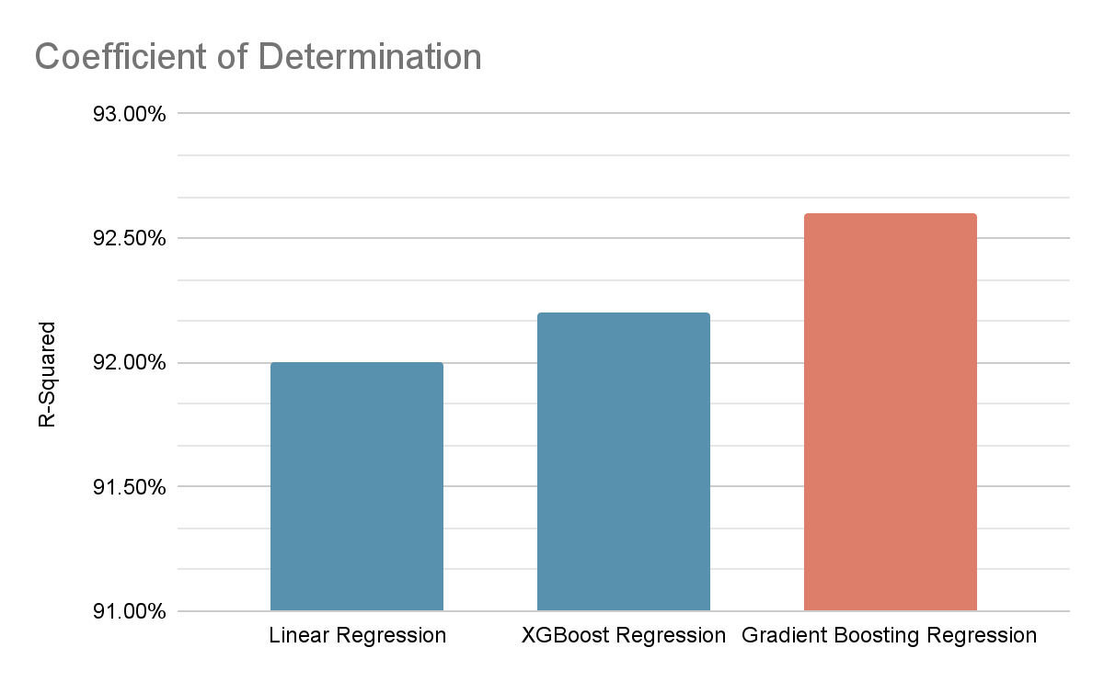
Burn Rate Prediction
Notes:
Testing out different regression model, including NN, we arrived at the conclusion that these three models provided the best performance, in terms of their coefficient of determination. In the end, gradient boosting provided the best performance and we ended up utilizing it for this analysis.
Models:
Linear Regression (92.0%)
XGBoost Regression (92.2%)
Gradient Boosting Regression (92.6%)
Metrics to Evaluate Performance:
Coefficient of Determination(R-Squared)

Slide 7
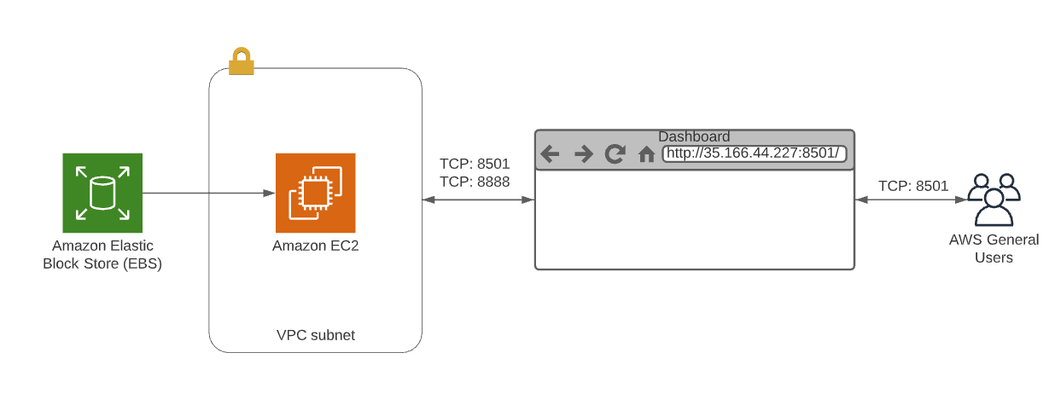
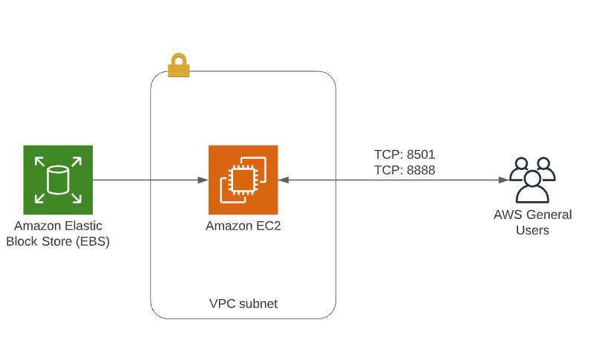
AWS Deployment Diagram
Work in Progress
Notes:
Since our model wasn’t computationally expensive, we probably ended up under-utilizing AWS. We used the lowest-tier of processing power, and ended up using no more than 30GB of storage space. In the end, we ended up port-forwarding to have open access to the site. If you were to to to the IP shown here, with the associated port, you can access our dashboard.
For our AWS architecture, we used an EC2 instance and allowed all traffic in and out of ports 8501/8888 for access to our dashboard and jupyter notebook respectively.

Slide 8
OKR - Obstacles and Challenges
Models
Visuals
Deployment
Data Acquisition
Model Training with different methods
Development with Streamlit
Visualize models and analysis
Set up AWS Instance
Deploy models to AWS server
Model selection
Discard unwanted analysis
Unit Testing Visuals
Multi-users deployment
Notes:
As with any piece of work, we did have few obstacles. When it comes to our model, the challenging aspect was deciding the best model to utilize, as in the beginning we were not getting adequate performance on the models we attempted.
When it comes to the dashboard, the major challenge was deciding which information to displace and which information to discard, as well as unit testing the visuals to ensure they are robust enough to handle variations in data
When it comes to deployment, it would be accounting the port attack. Since there is open port access to the dashboard, it’s vulnerable to large incoming data.

Slide 9
References
Kaggle Dataset:
https://www.kaggle.com/blurredmachine/are-your-employees-burning-out?select=test.csv
Workplace Stress: a Silent Killer of Employee Health and Productivity
https://www.corporatewellnessmagazine.com/article/workplace-stress-silent-killer-employee-health-productivity#:~:text=With%20these%20attendant%20health%20effects,healthcare%20costs%20incurred%20by%20employers.
Employees: How to Cope with Job Stress and Build Resilience During COVID-19 Pandamic
https://www.cdc.gov/coronavirus/2019-ncov/community/mental-health-non-healthcare.html
Notes:
Listed here are some of the reference we use throughout the project and the presentation.
https://www.corporatewellnessmagazine.com/article/workplace-stress-silent-killer-employee-health-productivity#:~:text=With%20these%20attendant%20health%20effects,healthcare%20costs%20incurred%20by%20employers.
https://www.cdc.gov/coronavirus/2019-ncov/community/mental-health-non-healthcare.html

Slide 10
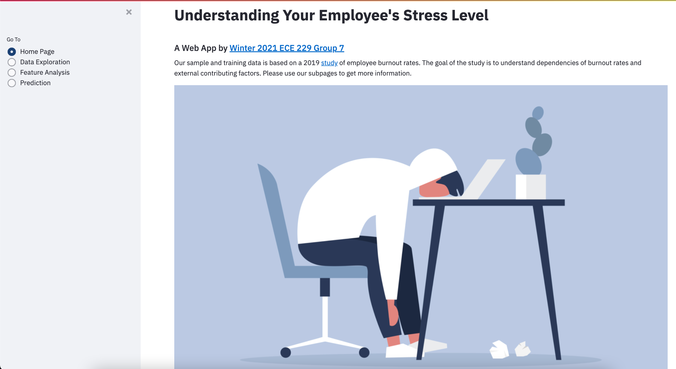
Dashboard Overview
Notes:
Now, I’ll transition over to Jessica, who will be going over the dashboard.
Qiyao Wu:
Feature analysis
Analysis of single variables correlations with Burn Rate
Date of Joining: no strong correlations with fatigue score found yet. The reason is that our data does not contain the date data is collected. The time interval is usually far more informative than a single date.
Gender: no strong correlations with fatigue score found, but Male's average fatigue score is relatively higher than female. This means that data may be clustered into two categories with regard to gender, but the difference is trivial.
Company Type: no strong correlations with fatigue score found. This means that the pressure exists no matter what you are working on. It does make sense!
WFH Setup Available: some negative correlation with fatigue score, average fatigue score without WFH setup is 6.3, with WFH setup available is 5.2. This reveals that the better work facilities help employees to release the pressure and anxiety in COVID19. They can keep their mind on work, and the comfortable working environment makes them feel more relaxed.
Designation: high correlation: 0.74 It makes sense because the workload is definitely positively related to the burnout rate.
Resource Allocation: high correlation: 0.86 More resource allocation usually leads to extra workload, therefore results in higher burnout rate.
Mental Fatigue Score: Mental Fatigue Score and Burn Rate are highly correlated, Correlation:0.9
Feature Engineering
We try some feature combination based on the result from the property of feature selection from tree methods. After careful analysis we preserve three feature combinations. Basically we first manually combine every features of high importance given from the boosting tree, then we run the LR(Linear Regression) to get the relative weight to see whether we should preserve combined features. The intuition behind feature combination is that cross features may have meaningful and useful latent features with regard to the target we analysis, namely burnout rate. In other words, the difference w.r.t the burnout rate will be observable if two or more features are jointly functioned.
Designation_Resource: Combined feature between Designation and Resource Allocation. Although they are both positively correlated to the burnout rate, the combination of two features may further strengthen two features because the resource allocation or designation may not directly leads to more workload because someone may enjoy more resources because of their positions or working environment. However, both more resource allocations and higher designation definitely leads to more tasks.
Designation_Gender_mfs: Combined feature among Designation, Gender and Mental Fatigue Score. It is interesting to find that the combination of gender and designation presents a relatively strong correlation to the burnout rate. This means that designation to different genders will increase the gap with regard to the burn rate.
Gender_WFH_mfs: Combined feature among Gender, WFH Setup Available and Mental Fatigue Score. Similar to the previous analysis, different genders suffer from different perssure in WFH settings.

Slide 11

Thank You for Listening!
Notes:
Thank you for listening, we’ll now open up the floor for Q&A!

